Slide 1
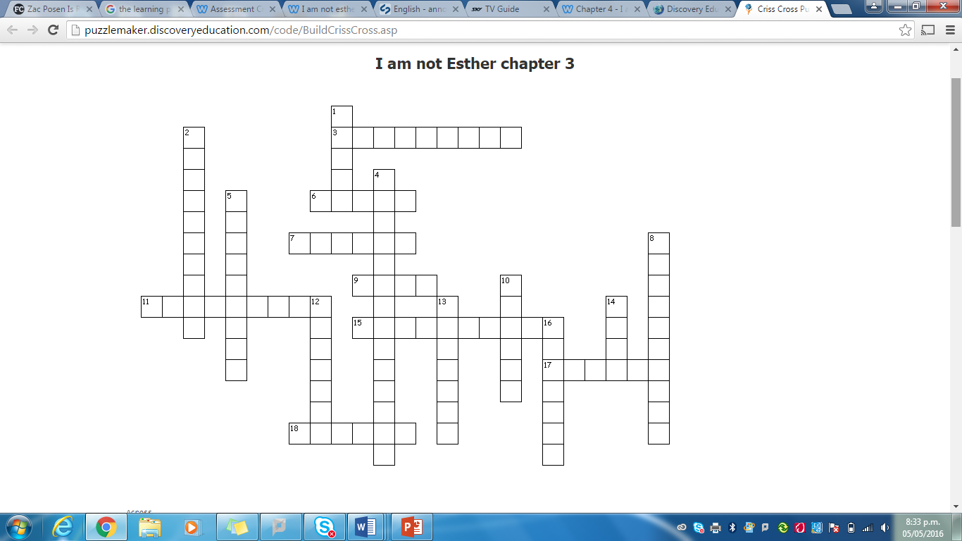
Across
3. Ellen's description of conditions in Africa
6. how many pieces of bread did Kirby have for dinner
7. Kirby would leave messages for Maggie under here
9. What did the children always have to make after breakfast?
11. Kirby's opinion of her own singing style
15. The name of the room where Kirby had to go to pray
17. The people who are in charge of the religion
18. Uncle Caleb wanted Kirby to recite these
Down
1. The religion is called The Children of the ________
2. This is how the elders describe Caleb's taking Kirby in
4. What does B.P. stand for in this chapter
5. Kirby was feeling 'frightened and _________
8. The circle meeting that Aunt Naomi wished Kirby would attend with her
10. The women of the faith always have to wear these
12. It was so quiet that Kirby could hear these screeching outside
13. The type of letters that Kirby found in Uncle Caleb's drawer
14. Kirby felt this emotion towards her mum for leaving her
16. Daniel smiled and raised one of these

Slide 2
Across
Down
1. faith
2. experiment
4. beforepilgrims
5. miserable
8. fellowship
10. skirts
12. cicadas
13. airmail
14. hate
16. eyebrows
3. Appalling
Three
Pillow
Beds
11. Fantastic
15. Discipline
17. Elders
18. Psalms

